Slide 1
EGB1201 – JAVA PROGRAMMING
Department of Electronics and Communication Engineering
Academic Year: 2024 – 2025 (Odd Semester)
Register Number :2303811710621115
Name :THOMAS LIVINGSTON G
Year :II
Semester :III
Section :B
Date :07.12.2024

Slide 2
Title of the Project
HOTEL MANAGEMENT SYSTEM

Slide 3
Problem Identification
Manual hotel management leads to errors (e.g., double bookings, billing issues) and operational inefficiency.
Challenges include tracking room availability, handling check-ins/check-outs, and maintaining customer data.

Slide 4
Objective
The primary objective of the Hotel Management System is to streamline hotel operations through automation. Specific objectives include:
Efficient Room Management: Centralized handling of room allocation, customer data storage, and booking tracking.
Accurate Billing and Secure Payment: Automation of bill calculation based on stay duration with secure payment handling.
Enhanced Transparency and Reliability: Improved operational accuracy using error validation, real-time feedback, and activity logging.

Slide 5
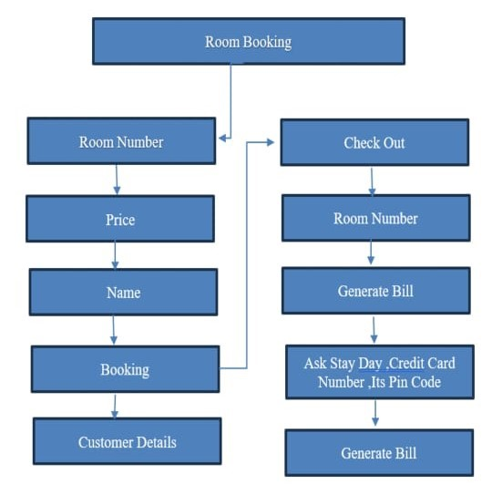
Proposed Architecture

Slide 6
Java Programming - Concepts Used
Object-Oriented Programming (OOP): Core principles like encapsulation, inheritance, and polymorphism ensure modular and scalable design.
Swing Framework: Used for developing a graphical user interface (GUI) to manage bookings, billing, and payments interactively.
Event-Driven Programming: Implemented using event listeners and handlers (e.g., ActionListener) for user interactions like button clicks.
Collections Framework: HashMap is employed for efficient data storage and retrieval (e.g., managing room prices and bookings).
Error Handling: try-catch blocks are used to validate inputs and prevent runtime crashes.
Input/Output Operations: Data is entered and retrieved using fields like JTextField, and results are displayed in text areas or dialogs.
String Manipulation: String methods validate inputs such as credit card numbers and names.
Dynamic Validation: Prevents invalid or incomplete input, ensuring data integrity.

Slide 7
List of Modules
Main Module
Room Booking Module
Billing and Check-Out Module
Error Handling and Validation Module
Data Management Module
Logging Module

Slide 8
Module Description
Main Module:
Serves as the application's entry point.
Initializes the GUI and ensures thread safety using SwingUtilities.invokeLater.
Room Booking Module:
Captures room details (room number, price) and customer information.
Stores data in HashMap, validates inputs, and logs booking activities.
Billing and Check-Out Module:
Manages check-out processes, calculates bills, and handles payments.
Logs billing activities and removes checked-out rooms from active bookings.

Slide 9
Module Description (Cont..)
Error Handling and Validation Module:
Ensures inputs are valid (e.g., not empty or in incorrect formats).
Displays error messages via JOptionPane to prevent invalid actions.
Data Management Module:
Uses HashMap to store and retrieve room bookings and pricing data efficiently.
Logging Module:
Records booking and billing activities in text areas for audit trails.
Provides accountability and transparency.

Slide 10
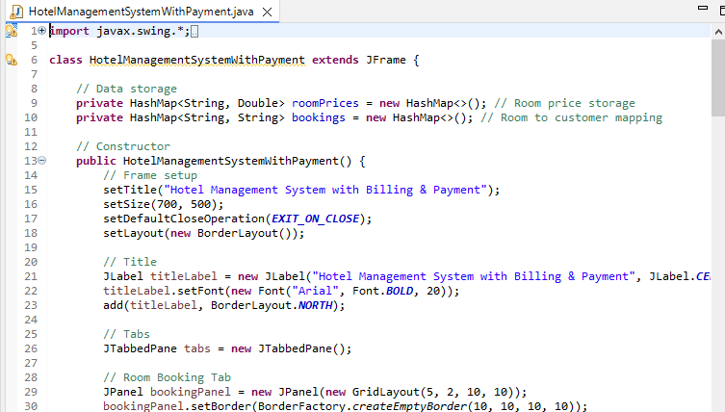
Source Code

Slide 11
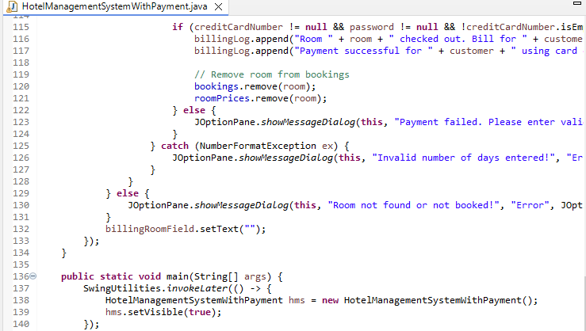
Source Code

Slide 12
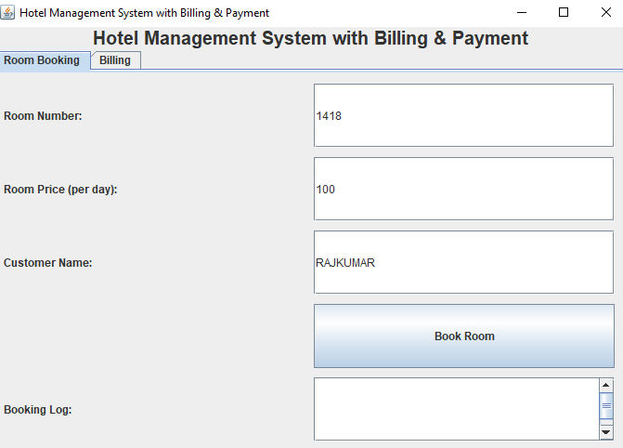
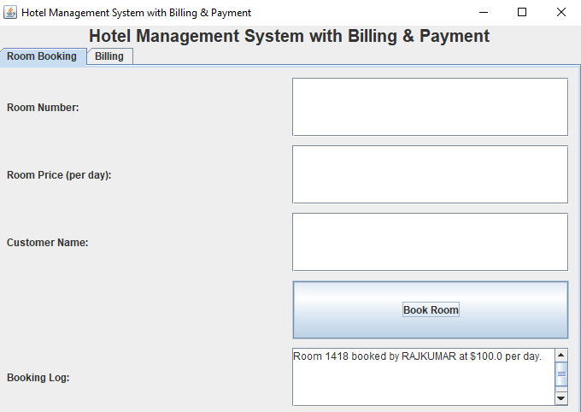
Results

Slide 13
Conclusion
The project demonstrates the application of core Java concepts to solve real-world problems in hotel management. By automating booking, billing, and payment, the system enhances efficiency, reduces errors, and improves customer satisfaction. The modular design ensures scalability, while Java's robust features ensure reliability. Future enhancements could include:
Integration of a database for persistent storage.
Advanced payment gateways for secure transactions.
Additional features like customer feedback collection and analytics.

Slide 14
Thank You
Any queries???

